Slide 1
Routing Protocols

Slide 2
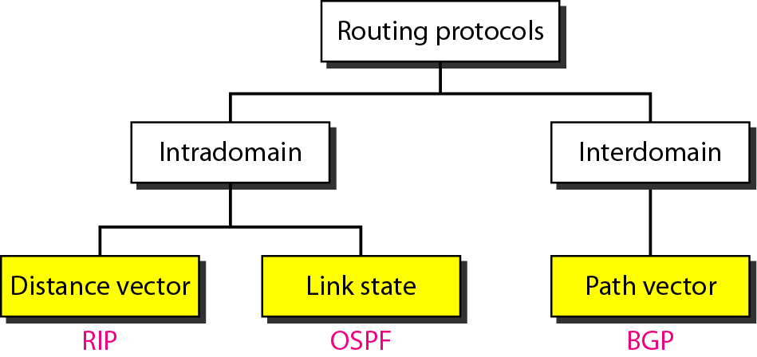
Popular routing protocols

Slide 3
Distance vector routing

Slide 4
In distance vector routing, each node shares its routing table with its
immediate neighbors periodically and when there is a change.
Tell your neighbors when you know about everyone

Slide 5
Distance Vector Algorithm
Bellman-Ford Equation (dynamic programming)
Define
d_{x}(y) := cost of least-cost path from x to y
Then
d_{x}(y) = min {c(x,v) + d_{v}(y) }
where min is taken over all neighbors of x

Slide 6
Bellman-Ford example
5
Clearly, d_{v}(z) = 5, d_{x}(z) = 3, d_{w}(z) = 3
v
3
w
2
5
u
z
B-F equation says:
2
1
3
1
2
d_{u}(z) = min { c(u,v) + d_{v}(z),
c(u,x) + d_{x}(z),
c(u,w) + d_{w}(z) }
= min {2 + 5,
1 + 3,
5 + 3} = 4
x
y
1
Node that achieves minimum is next
hop in shortest path ➜ forwarding table

Slide 7
Distance Vector Algorithm
D_{x}(y) = estimate of least cost from x to y
Distance vector: D_{x} = [D_{x}(y): y є N ]
Node x knows cost to each neighbor v: c(x,v)
Node x maintains D_{x} = [D_{x}(y): y є N ]
Node x also maintains its neighbors’ distance vectors
  For each neighbor v, x maintains
  D_{v} = [D_{v}(y): y є N ]

Slide 8
Distance vector algorithm
Basic idea:
Each node periodically sends its own distance vector estimate to neighbors
When node a node x receives new DV estimate from neighbor, it updates its own DV using B-F equation:
D_{x}(y) ← min_{v}{c(x,v) + D_{v}(y)} for each node y ∊ N
Under minor, natural conditions, the estimate D_{x}(y) converge the actual least cost d_{x}(y)

Slide 9
Overview
Distance vector
  Assume each router knows its own address and cost to reach each of its directly connected neighbors
Bellman-Ford algorithm
  Distributed route computation using only neighbor’s info
Mitigating loops
  Split horizon and posion reverse

Slide 10
Bellman-Ford Algorithm
Define distances at each node X
  d_{x}(y) = cost of least-cost path from X to Y
Update distances based on neighbors
  d_{x}(y) = min {c(x,v) + d_{v}(y)} over all neighbors V
v
2
y
3
1
1
x
4
u
z
2
1
5
d_{u}(z) = min{c(u,v) + d_{v}(z),
c(u,w) + d_{w}(z)}
t
w ₄
3
s

Slide 11
Distance Vector Algorithm
Iterative, asynchronous:
each local iteration caused by:
Local link cost change
Distance vector update message from neighbor
Distributed:
Each node notifies neighbors
only when its DV changes
Neighbors then notify their neighbors if necessary
Each node:
wait for (change in local link cost or message from neighbor)
recompute estimates
if distance to any destination has changed, notify neighbors

Slide 12
Step-by-Step
c(x,v) = cost for direct link from x to v
  Node x maintains costs of direct links c(x,v)
D_{x}(y) = estimate of least cost from x to y
  Node x maintains distance vector D_{x} = [D_{x}(y): y є N ]
Node x maintains its neighborsʼ distance vectors
  For each neighbor v, x maintains D_{v} = [D_{v}(y): y є N ]
Each node v periodically sends D_{v} to its neighbors
  And neighbors update their own distance vectors
  D_{x}(y) ← min_{v}{c(x,v) + D_{v}(y)} for each node y ∊ N

Slide 13
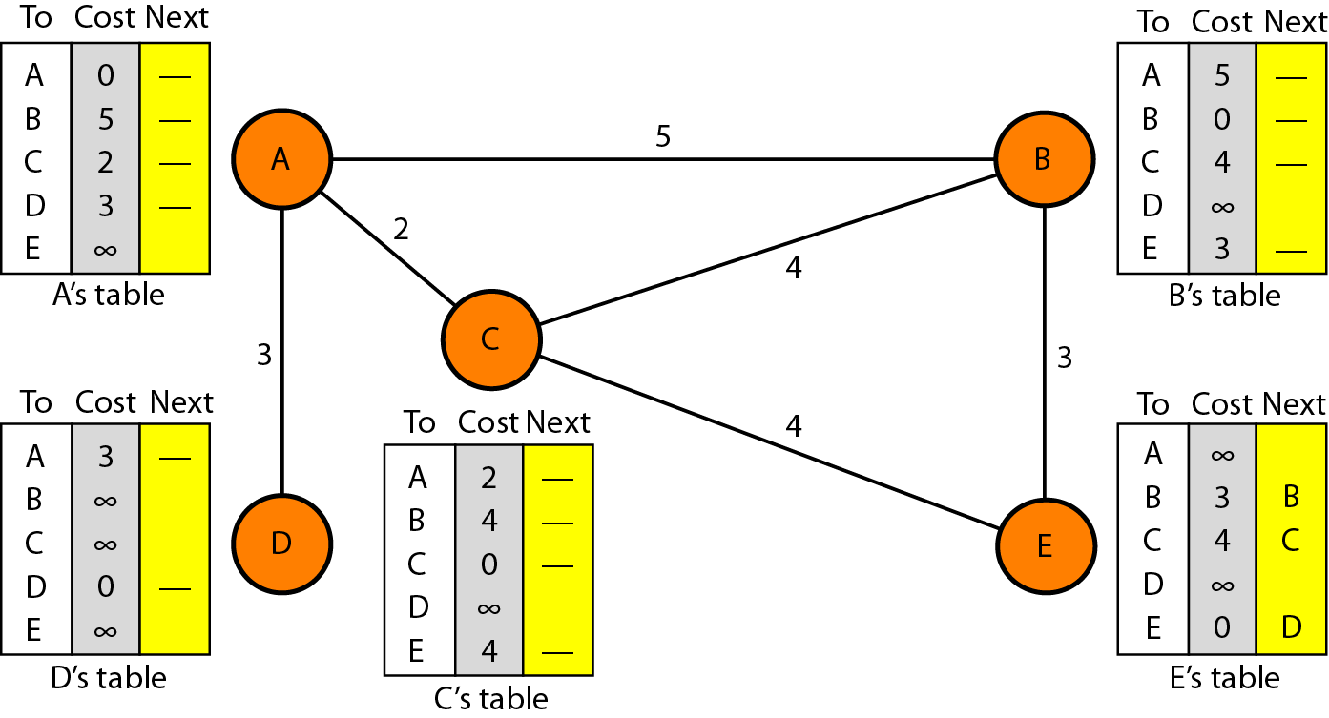
Routing table for node A

Slide 14
Initialization of tables in distance vector routing

Slide 15
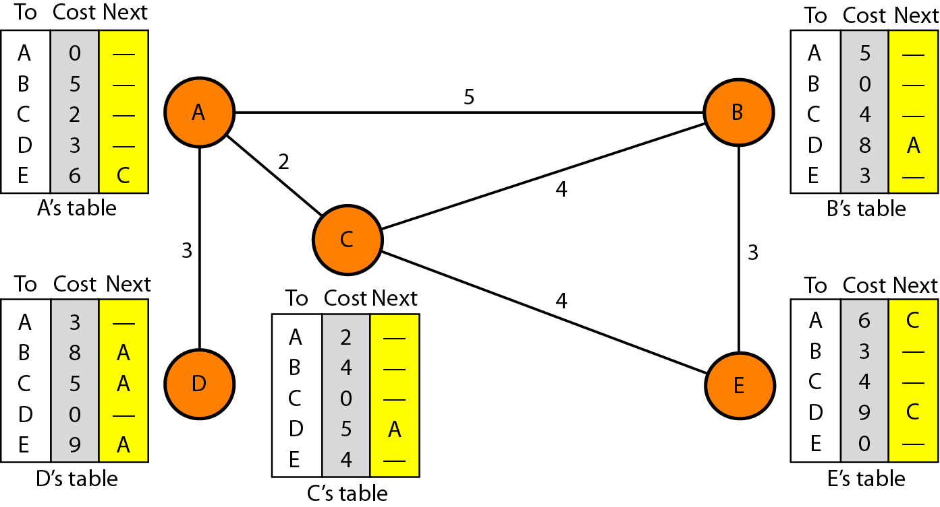
Distance vector routing tables

Slide 16
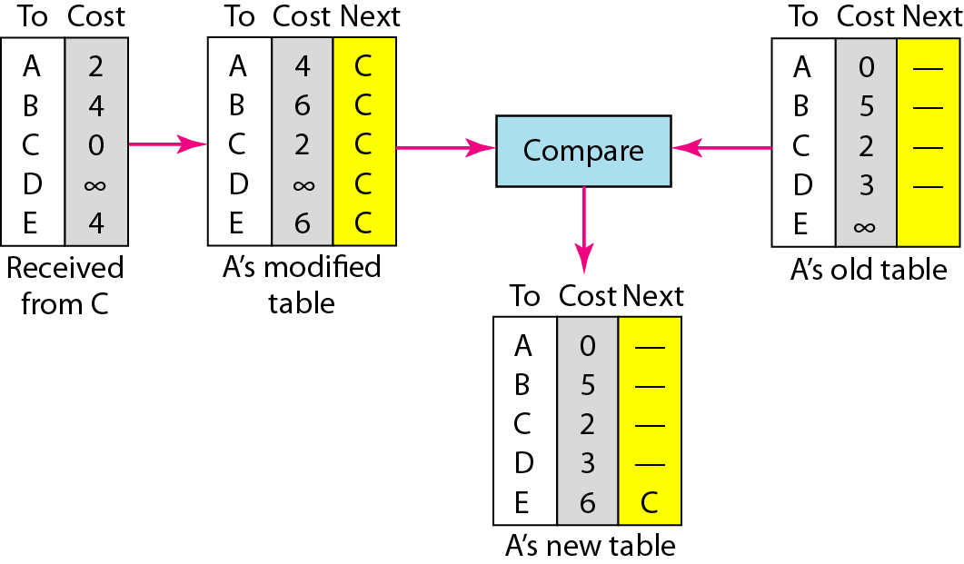
Updating in distance vector routing

Slide 18
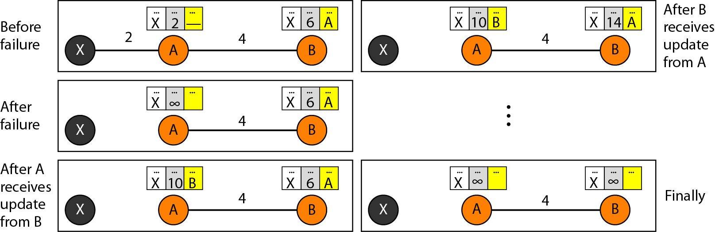
Two-node instability

Slide 19
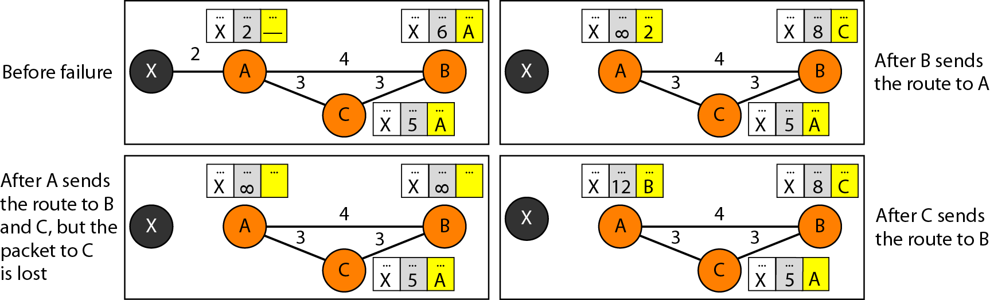
Three-node instability

Slide 20
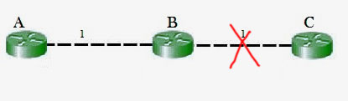
The main issue with Distance Vector Routing (DVR) protocols is Routing Loops since Bellman-Ford Algorithm cannot prevent loops.
This routing loop in the DVR network causes the Count to Infinity Problem.
Routing loops usually occur when an interface goes down or two routers send updates at the same time.
If the link between B and C is disconnected, then B will know that it can no longer get to C via that link and will remove it from its table. Before it can send any updates it’s possible that it will receive an update from A which will be advertising that it can get to C at a cost of 2. B can get to A at a cost of 1, so it will update a route to C via A at a cost of 3. A will then receive updates from B later and update its cost to 4. They will then go on feeding each other bad information toward infinity which is called as Count to Infinity problem.

Slide 21
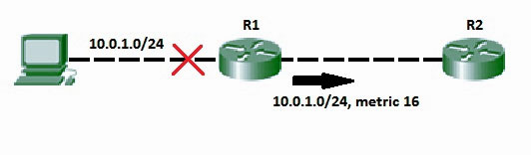
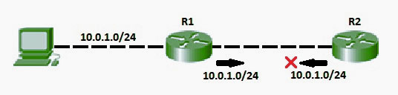
Solution for Count to Infinity problem:-
Route Poisoning:
When a route fails, distance vector protocols spread the bad news about a route failure by poisoning the route. Route poisoning refers to the practice of advertising a route, but with a special metric value called Infinity. Routers consider routes advertised with an infinite metric to have failed. Each distance vector routing protocol uses the concept of an actual metric value that represents infinity. RIP defines infinity as 16. The main disadvantage of poison reverse is that it can significantly increase the size of routing announcements in certain fairly common network topologies.
Split horizon:
If the link between B and C goes down, and B had received a route from A, B could end up using that route via A. A would send the packet right back to B, creating a loop. But according to the Split horizon Rule, Node A does not advertise its route for C (namely A to B to C) back to B. On the surface, this seems redundant since B will never route via node A because the route costs more than the direct route from B to C.

Slide 22
In addition to these, we can also use split horizon with route poisoning were above both techniques will be used combined to achieve efficiency and less increase the size of routing announcements.
Split horizon with Poison reverse technique is used by Routing Information Protocol (RIP) to reduce routing loops. Additionally, Holddown timers can be used to avoid the formation of loops. The hold-down timer immediately starts when the router is informed that the attached link is down. Till this time, the router ignores all updates of the down route unless it receives an update from the router of that downed link. During the timer, If the downlink is reachable again, the routing table can be updated.

Slide 23
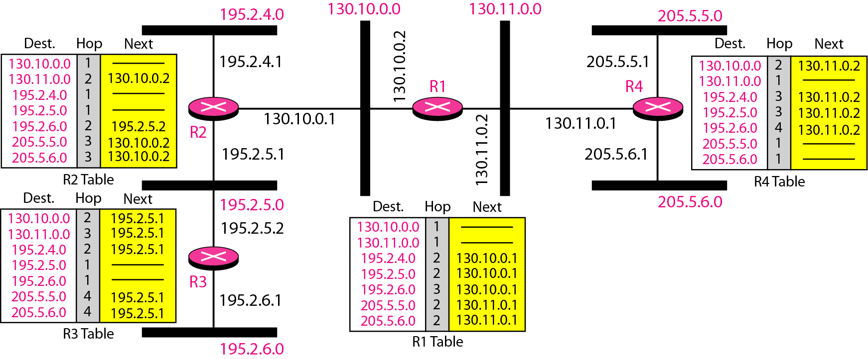
Example of a domain using RIP

Slide 27
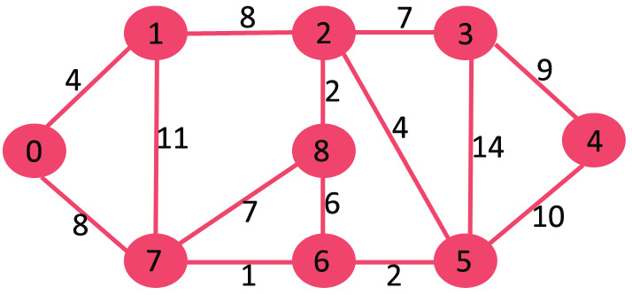

Slide 28

